Slide 1

Academic
Vocabulary
High Frequency Words Vol. 2

Slide 2
About Academic Vocabulary
Academic vocabulary refers to words that you will likely encounter in an academic setting.
Academic vocabulary shows up in text books, standardized tests, and in instructions for school assignments.
The more academic vocabulary you know, the more likely you are to be successful in school!

Slide 3
About Academic Vocabulary
The Academic Vocabulary words you’ll encounter in this unit are high-frequency vocabulary words that appear frequently in academic texts.

Slide 4
Focus on Five at a Time
We will learn 25 new academic vocabulary terms during this unit.
However, we will only focus on five words at a time.
Each week we will have five new words to learn.

Slide 5
Our Week in Academic Vocabulary
Monday: Introduce the words.
Tuesday: Draw it out.
Wednesday: Word Web Wednesday!
Thursday: Reflect about the words.
Friday: Quiz time!
End of the unit: We will review ALL 25 of the academic words you’ve learned.

Slide 6
Monday
On Mondays, we will take a quick pretest on five new vocabulary words.
Then, we will go over each word.
You’ll write the words and their definitions on your weekly handout.

Slide 7
Tuesday
On Tuesdays, we will take a few minutes to review the words.
During this time, you’ll draw a quick visual representation for each word.
The drawings do not need to be perfect. Anything that helps you associate the word to the definition will help you!

Slide 8
Wednesday
On Wednesdays, we will take a few minutes to review the words.
During this time, you’ll create a word web for each word.
A word web is a graphic representation containing words. You’ll write words that have similar meanings and words that are associated with the vocabulary term on your paper.

Slide 9
Word Web Example
language
list
vocabulary
terms
words

Slide 10
Thursday
On Thursdays, we will take a few minutes to review the words.
During this time, you’ll look over all of the work from the week and write a brief reflection about what you learned.
Your reflection should be at least three sentences long and contain some of the vocabulary words.

Slide 11
Reflect/Journal
Your vocabulary journal/reflection should be at least three sentences long. You can use these questions to help get you started.
What did you learn about the words?
What word did you not know prior to this week?
How do these words relate to one another?
How will knowing these words help you succeed in an academic setting?

Slide 12
Friday
On Fridays, we will take a quick test on five vocabulary words from the week.
After the test, you’ll record your score and write down the words you still need to study.
As we continue with new words, make sure you go back and revisit the words you still need to learn.

Slide 13

Academic
Vocabulary
High Frequency Words Vol. 2

Slide 14
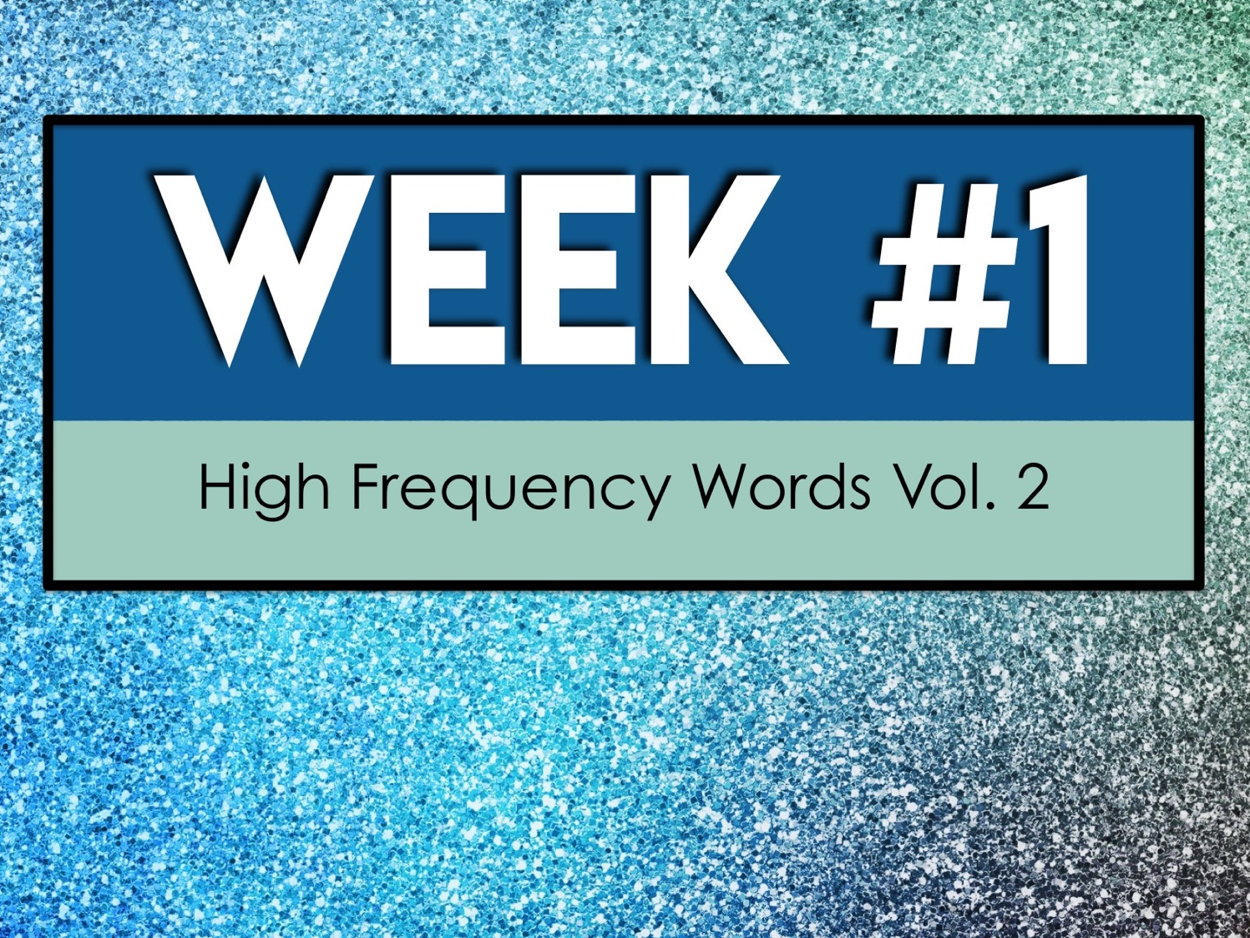
Week #1
High Frequency Words Vol. 2

Slide 15
Week #1 Words
Concept
Conclude
Conduct
Confirm
Conform

Slide 16
Week #1 Pretest
DIRECTIONS: In your own words, try your best to define each term.
Concept
Conclude
Conduct
Confirm
Conform

Slide 17
Concept
an abstract or general idea

Slide 18
Conclude
to reach a decision or agreement

Slide 19
Conduct
organize or carry out

Slide 20
Confirm
establish the truth or correctness of something

Slide 21
Conform
comply with rules, standards, or laws

Slide 22
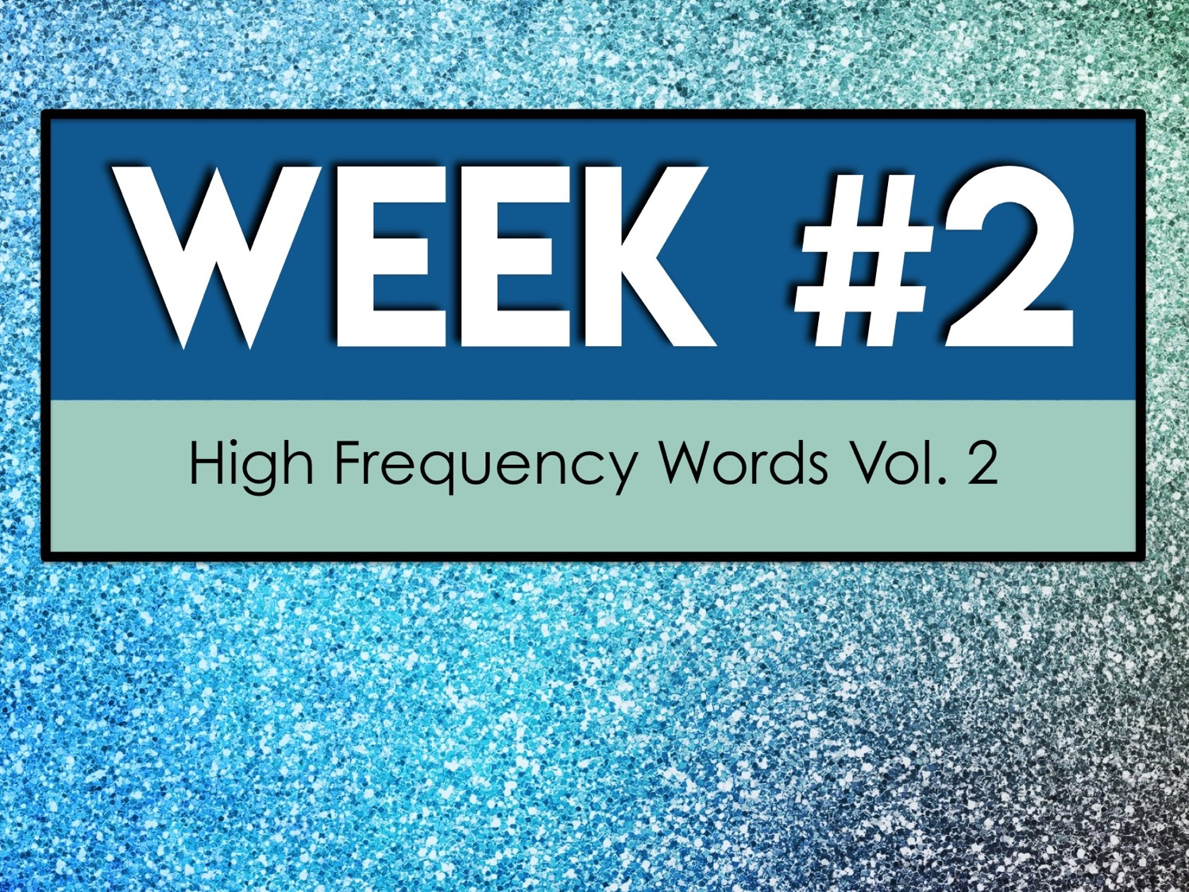
Week #2
High Frequency Words Vol. 2

Slide 23
Week #2 Words
Consent
Consist
Constitute
Construct
Context

Slide 24
Week #2 Pretest
DIRECTIONS: In your own words, try your best to define each term.
Consent
Consist
Constitute
Construct
Context

Slide 25
Consent
permission for something to happen or agreement to do something

Slide 26
Consist
to be composed or made up of

Slide 27
Constitute
to compose; form

Slide 28
Construct
to build or form by putting together parts

Slide 29
Context
the set of circumstances or facts that surround a particular event, situation, etc.

Slide 30

Week #3
High Frequency Words Vol. 2

Slide 31
Week #3 Words
Contract
Contradict
Contribute
Convince
Cooperate

Slide 32
Week #3 Pretest
DIRECTIONS: In your own words, try your best to define each term.
Contract
Contradict
Contribute
Convince
Cooperate

Slide 33
Contract
an agreement between two or more parties

Slide 34
Contradict
to assert the contrary or opposite of

Slide 35
Contribute
to give to a common supply, fund, etc.

Slide 36
Convince
to move by argument or evidence to believe, agreement, consent

Slide 37
Cooperate
to work or act together

Slide 38
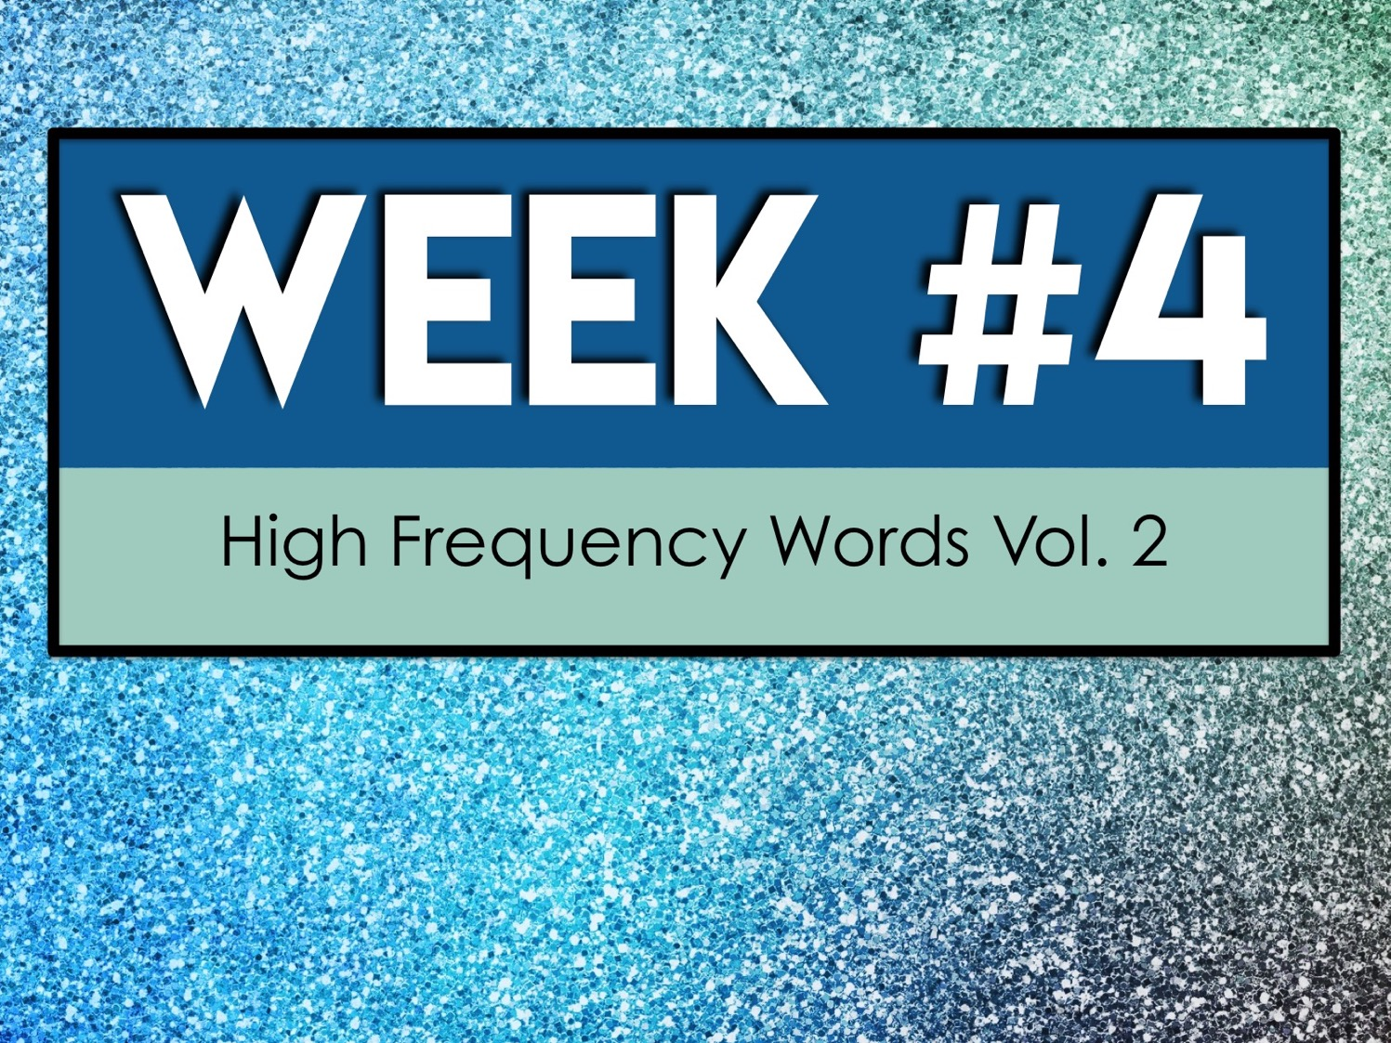
Week #4
High Frequency Words Vol. 2

Slide 39
Week #4 Words
Create
Define
Diminish
Discreet
Display

Slide 40
Week #4 Pretest
DIRECTIONS: In your own words, try your best to define each term.
Create
Define
Diminish
Discreet
Display

Slide 41
Create
to cause to happen

Slide 42
Define
to explain or identify

Slide 43
Diminish
to make or cause to seem smaller, less, less important, etc.

Slide 44
Discreet
showing prudence and circumspection

Slide 45
Display
to show or exhibit

Slide 46
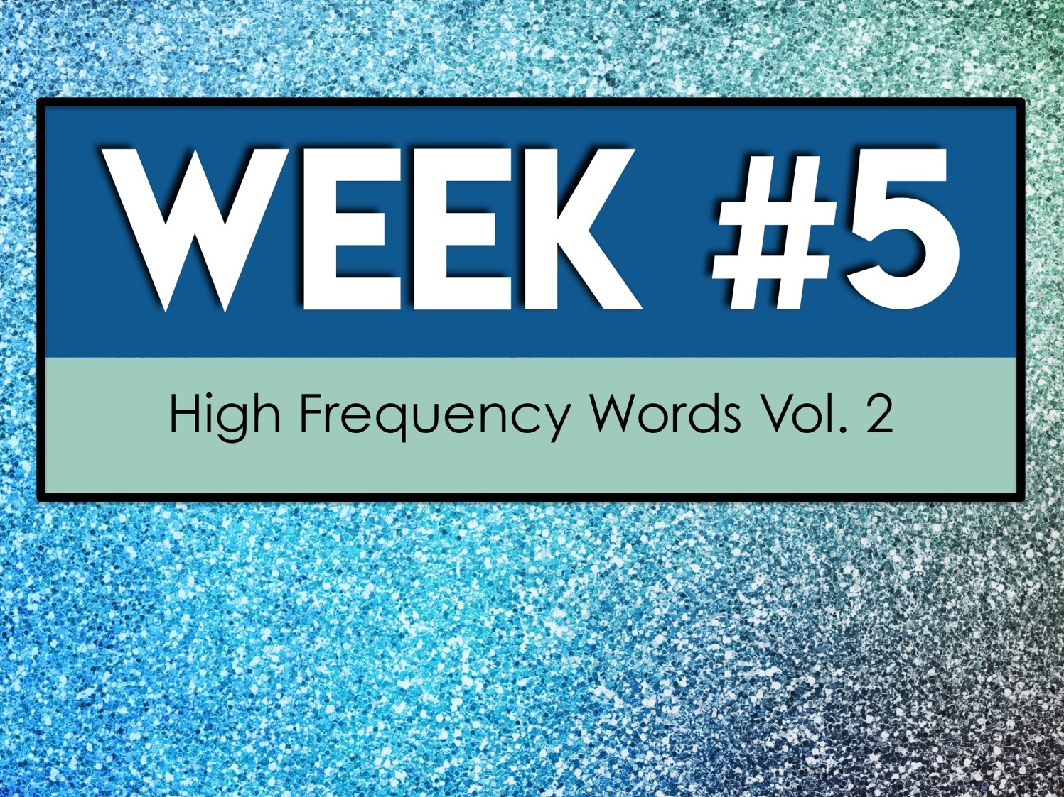
Week #5
High Frequency Words Vol. 2

Slide 47
Week #5 Words
Diverse
Document
Domain
Dynamic
Emphasis

Slide 48
Week #5 Pretest
DIRECTIONS: In your own words, try your best to define each term.
Diverse
Document
Domain
Dynamic
Emphasis

Slide 49
Diverse
of various kinds or forms

Slide 50
Document
to furnish with references, citations, etc.

Slide 51
Domain
a field of action, thought, influence, etc.

Slide 52
Dynamic
pertaining to or characterized by energy or effective action

Slide 53
Emphasis
special stress laid upon, or importance attached to

